Slide 1
STOR 455 Effects of a Categorical Variable
Read: 3.3
Exercises: 3.30, 31, 48

Slide 2
Example: Legos
Response Variable:
Y =Amazon Price
Predictors:
X₁ = Pieces
X₂ = Theme (Star Wars or Friends)

Slide 3
Review of Categorical Predictor
Example:
Response = Y = Amazon Price
Predictor = X = Theme
Are Amazon Prices related to lego themes?
“Usual” procedure?
Two-sample t-test (difference in means or intercepts)

Slide 4
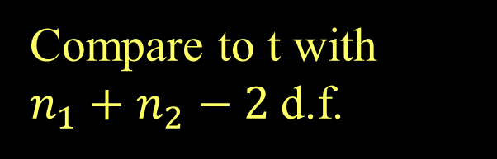
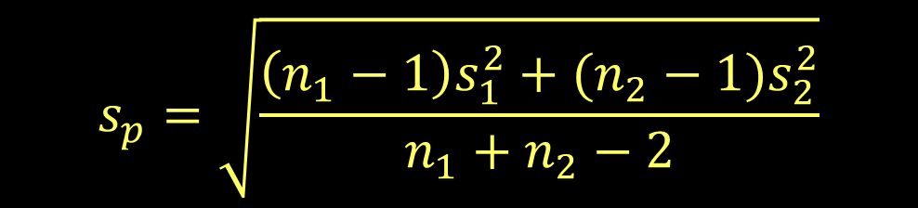

Two-sample T-test for Means
(using pooled variances)
H_{o}: μ₁ = μ₂
H_{a}: μ₁ ≠ μ₂
$$t=\frac{{\overline{y}}_{1}−{\overline{y}}_{2}}{s_{p}\sqrt{\frac{1}{n_{1}}+\frac{1}{n_{2}}}}$$
Compare to t with $n_{1}+n_{2}−2$d.f.
where:
$$s_{p}=\sqrt{\frac{\left(n_{1}−1\right)s_{1}^{2}+{(n_{2}−1)s}_{2}^{2}}{n_{1}+n_{2}−2}}$$
(pooled standard deviation)

Slide 5
R - Two-sample T-test
> t.test(Amazon_Price~Theme, var.equal=TRUE, data=lego2)
data: Amazon_Price by Theme
t = -3.2299, df = 181, p-value = 0.001471
alternative hypothesis: true difference in means between group Friends and group Star Wars is not equal to 0
95 percent confidence interval:
-61.92623 -14.95793
sample estimates:
mean in group Friends mean in group Star Wars
42.26448 80.70656
This difference is “significant”

Slide 6
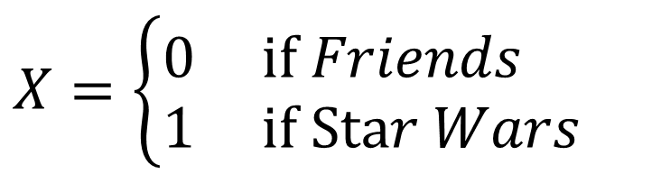
Coding “Dummy” Predictors
We can code a categorical predictor as (0,1)
How should this be interpreted in a regression?
Example: Y = Amazon Price
$$X=\left\{\begin{aligned}&0 \text{if} Friends \\ &1 \text{if} \text{Sta}r Wars\end{aligned}\right.$$

Slide 7
Two-sample T-test vs. Dummy Regression
modlego=lm(Amazon_Price~Theme, data=lego2)
summary(modlego)
Estimate Std. Error t value Pr(>|t|)
(Intercept) 42.26 8.62 4.903 2.09e-06 ***
ThemeStar Wars 38.44 11.90 3.230 0.00147 **
Residual standard error: 80.4 on 181 degrees of freedom
(39 observations deleted due to missingness)
Multiple R-squared: 0.0545, Adjusted R-squared: 0.04927
F-statistic: 10.43 on 1 and 181 DF, p-value: 0.00147
Mean for Friends
Difference for Star Wars
t.test(Amazon_Price~Theme, var.equal=TRUE, data=lego2)
Two Sample t-test
data: Amazon_Price by Theme
t = -3.2299, df = 181, p-value = 0.001471
alternative hypothesis: true difference in means between group Friends and group Star Wars is not equal to 0
95 percent confidence interval:
-61.92623 -14.95793
sample estimates:
mean in group Friends mean in group Star Wars
42.26448 80.70656
t-test for significant difference
Mean for Friends
Mean for Star Wars

Slide 8
Quantitative + Indicator Predictors
Example: Y = Amazon Price
X₁ = Pieces
X₂ = Theme (Friends or Star Wars
Estimate Std. Error t value Pr(>|t|)
(Intercept) -0.082759 4.258263 -0.019 0.9845
Pieces 0.143271 0.005468 26.203 <2e-16 ***
ThemeStar Wars 9.803090 5.548089 1.767 0.0789
$$\hat{Amazon_Price}=\text{−0.082759}+\text{0.143271}Pieces+\text{9.803090}Theme$$
How do we interpret the coefficient of theme?

Slide 9
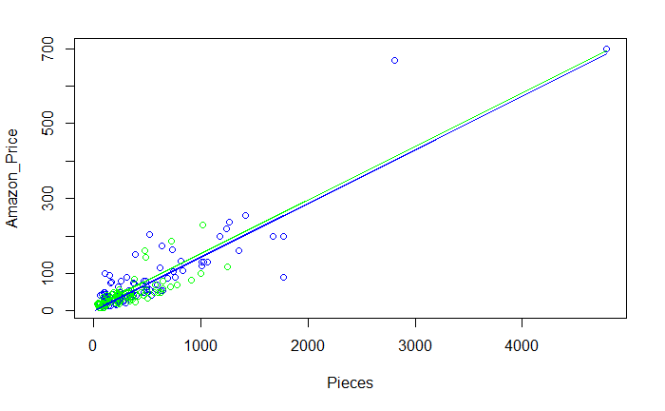
$$\hat{Amazon_Price}=\text{−0.082759}+\text{0.143271}Pieces+\text{9.803090}Theme$$
Same slope, different intercepts

Slide 10

Quantitative + Indicator Predictors
H_{o}: β₂ = 0
H_{a}: β₂ ≠ 0
$$\hat{Amazon_Price}=\text{−0.082759}+\text{0.143271}Pieces+\text{9.803090}Theme$$
Estimate Std. Error t value Pr(>|t|)
(Intercept) -0.082759 4.258263 -0.019 0.9845
Pieces 0.143271 0.005468 26.203 <2e-16 ***
ThemeStar Wars 9.803090 5.548089 1.767 0.0789
$$There is not evidence to reject the null hypothesis$$
$and suggest that$β₂ ≠ 0

Slide 11
Fit Models to Subsets
StarWars = subset(lego2, Theme == 'Star Wars')
modelSW = lm(Amazon_Price ~ Pieces, data = StarWars)
summary(modelSW)
Estimate Std. Error t value Pr(>|t|)
(Intercept) 7.552803 5.695614 1.326 0.188
Pieces 0.147646 0.007023 21.023 <2e-16 ***
$\hat{Amazon_Price}=\text{7.552803}+\text{0.147646}Pieces$ (Star Wars)
Friends = subset(lego2,Theme == 'Friends')
modelF = lm(Amazon_Price ~ Pieces, data = Friends)
summary(modelF)
Estimate Std. Error t value Pr(>|t|)
(Intercept) 9.0640 4.1297 2.195 0.0309 *
Pieces 0.1123 0.0106 10.592 <2e-16 ***
$\hat{Amazon_Price}=\text{9.0640}+\text{0.1123}Pieces$ (Friends)

Slide 12
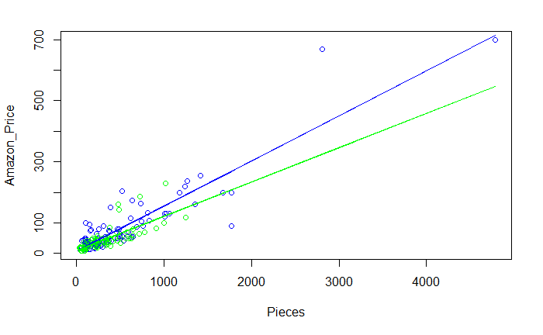
Are these lines “significantly” different?
Star Wars
Friends

Slide 13
Comparing Two Regression Lines (with a multiple regression)
Example:
Y=Amazon Price
X₁= Pieces X₂= Theme(0,1)
Quantitative
Indicator
Interaction

Slide 14
MTB output to compare two lines
Quantitative + Indicator +Interaction
modlegoint=lm(Amazon_Price ~ Pieces + Theme + Pieces*Theme, data=lego2)
summary(modlegoint)
Estimate Std. Error t value Pr(>|t|)
(Intercept) 9.06395 5.99060 1.513 0.132
Pieces 0.11233 0.01538 7.302 8.96e-12 ***
ThemeStar Wars -1.51114 7.60839 -0.199 0.843
Pieces:ThemeStar Wars 0.03532 0.01643 2.149 0.033 *
---
Residual standard error: 36.38 on 179 degrees of freedom
(39 observations deleted due to missingness)
Multiple R-squared: 0.8085, Adjusted R-squared: 0.8053
F-statistic: 252 on 3 and 179 DF, p-value: < 2.2e-16
$$\hat{Amazon_Price}=\text{9.06395}+\text{0.11233}Pieces\text{−1.51114}Theme+\text{0.03532}Pieces∗Theme$$
How does this relate to the two lines?
Substitute Theme=0 and Theme=1

Slide 15
Tests to Compare Two Regression Lines
$$Y=β_{0}+β_{1}X_{1}+β_{2}X_{2}+β_{3}X_{1}X_{2}+ε$$
Different slope?
H_{o}: β₃ = 0
H_{a}: β₃ ≠ 0
How do we test just a subset of predictors?
(t-test)
Different intercept?
H_{o}: β₂ = 0
H_{a}: β₂ ≠ 0
(t-test)
Different lines?
H_{o}: β₂ = β₃ = 0
H_{a}: β₂ ≠ 0 or β₃ ≠ 0
(???)

Slide 16
Multiple regression model
$$Y=β_{0}+β_{1}X_{1}+β_{2}X_{2}+…+β_{k}X_{k}+ε$$
We can test…
One term at a time: (t-test)
H_{o}: β_{i}=0
H_{a}: β_{i}≠0
All terms at once: (ANOVA)
H_{o}: β₁= β₂= ...=β_{k}= 0
H_{a}: Some β_{i}≠0
Is there anything in between?

Slide 17
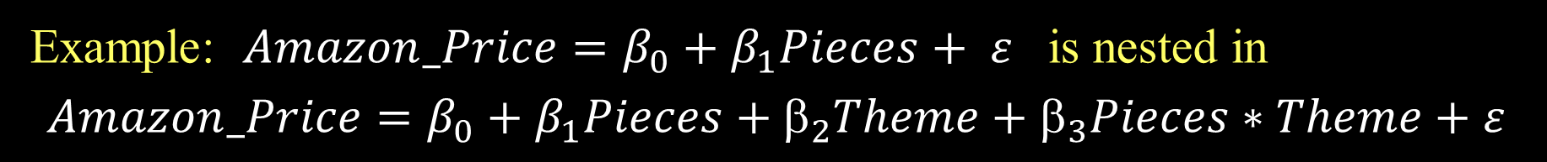
Nested Models
Definition: If all of the predictors in Model A are also in a bigger Model B, we say that Model A is nested in Model B.
Example: $Amazon_Price=β_{0}+β_{1}Pieces+ ε$ is nested in
$$Amazon_Price=β_{0}+β_{1}Pieces+_{2}Theme+_{3}Pieces∗Theme+ε$$
Test for Nested Models:
Do we really need the extra terms in Model B?
i.e. How much do they “add” to Model A?

Slide 18
Nested F-test
Basic idea:
1. Find how much “extra” variability is explained when the “new” terms being tested are added.
2. Divide by the number of new terms to get a mean square for the new part of the model.
3. Divide this mean square by the MSE for the “full” model to get an F-statistic.
4. Compare to an F-distribution to find a p-value.

Slide 19
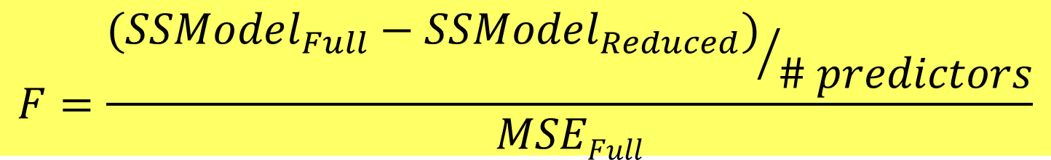
Nested F-test
Test: H_{o}: β_{i}=0 for a “subset” of predictors
H_{a}: β_{i}≠0 for some predictors in the subset
Explained by full model
Explained by reduced model
$$F=\frac{{(SSModel_{Full}−SSModel_{Reduced})}/{\# predictors}}{MSEFull}$$
#predictors tested in H₀
Based on full model
Compare to F-distribution

Slide 20
Nested F-test
$$Amazon_Price=β_{0}+β_{1}Pieces+_{2}Theme+_{3}Pieces∗Theme+ε$$
H₀: β₂=β₃=0
H_{a}: Some β_{i}≠0
Compare mean square for the “extra” variability to the mean square error for the full model.
anova(modlego_Reduced, modlegoint)
Analysis of Variance Table
Model 1: Amazon_Price ~ Pieces
Model 2: Amazon_Price ~ Pieces + Theme + Pieces * Theme
Res.Df RSS Df Sum of Sq F Pr(>F)
1 181 247273
2 179 236943 2 10330 3.902 0.02194 *

